Slide 1



Transforming Data into Insight: A Power BI Overview
SALES INSIGHTS : TRENDS AND RETURNS
BY : NIKHIL DADWAL

Slide 2
INTRODUCTION
Welcome to our presentation on leveraging Power BI for data analysis and visualization. Today, we will explore how Power BI can transform complex datasets into insightful dashboards that drive decision-making and enhance business strategies.
In the accompanying table, we have a comprehensive dataset that includes various elements such as Orders, Returns, People, Categories, and Sales Metrics. This dataset serves as the foundation for our analysis, enabling us to track and visualize key performance indicators (KPIs) like sales volume, returns, and customer segmentation.
Power BI provides powerful tools for data integration, transformation, and visualization, allowing us to create interactive reports and dashboards that present our data in a clear and engaging manner. By utilizing features such as matrix visuals, gauge charts, and funnel charts, we can gain deeper insights into our sales performance and identify trends that inform future strategies.
Join us as we delve into the features and functionalities of Power BI, demonstrating how it can help organizations make data-driven decisions and achieve their business objectives.

Slide 3
BUISINESS PROBLEM’S
Identifying the Top-Performing City: We aim to pinpoint which city generates the highest sales, allowing the business to focus on high-growth areas and allocate resources efficiently.
Service-Based Profitability: Our objective is to evaluate the total profit earned from various services offered. This insight helps in determining which services are the most profitable and where there may be opportunities to increase profit margins.
Return Orders by Product Category: We are analyzing the volume of return orders across different product categories. Understanding these patterns will help address quality issues and improve customer satisfaction in specific categories.

Slide 4
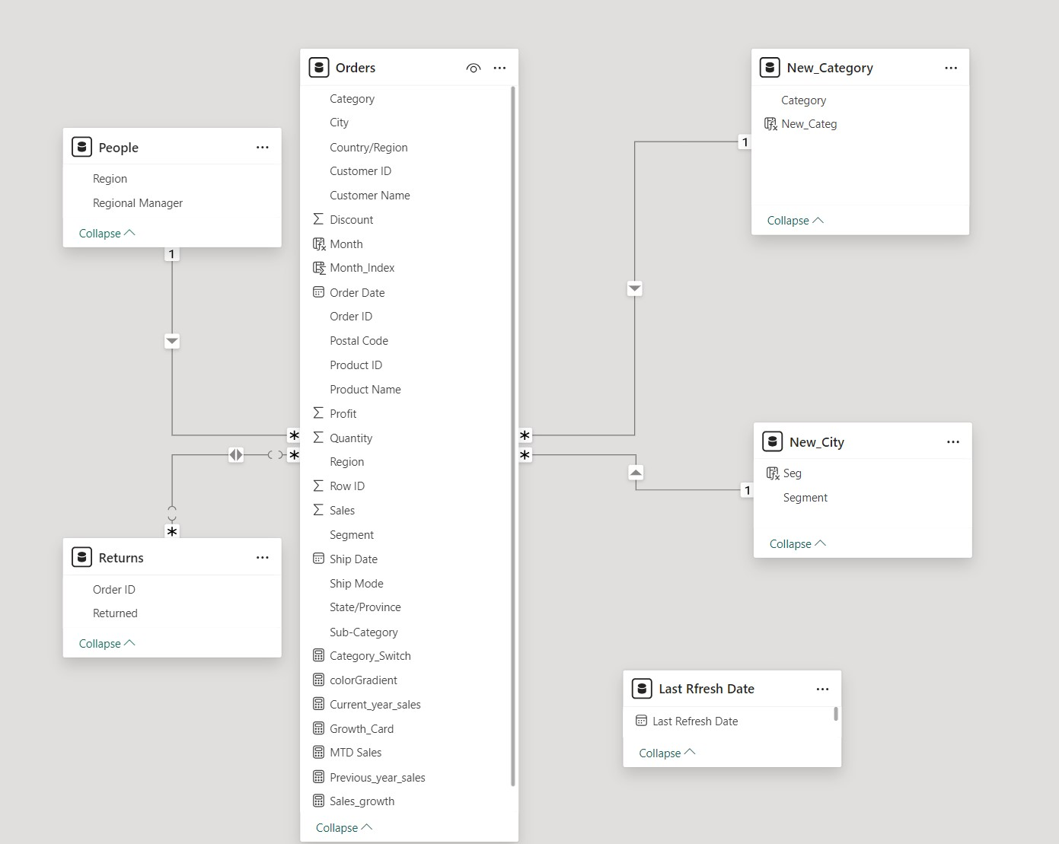
DATASET OVERVIEW :

Slide 5
FIELD’S OVERVIEW
Orders Table:
Fields:
Order ID: Unique identifier for each order.
Product ID: Identifier for the product sold.
Product Name: Name of the product.
Category: Category to which the product belongs.
Sub-Category: Specific sub-category of the product.
Order Date: Date the order was placed.
Quantity: Number of units sold.
Sales: Total sales amount for the order.
Profit: Profit earned from the order.
Region: Geographical area of the sale.
Segment: Customer segment (e.g., consumer, corporate).
Returns Table:
Fields:
Order ID: Reference to the associated order.
Returned: Indicator showing if the product was returned.
People Table:
Fields:
Region: The region where the customers are located.
Regional Manager: Name of the regional manager overseeing sales in that area.
New_Category Table:
Fields:
Category: Category identifier.
New_Categ: New category designation.
New_City Table:
Fields:
Seg: Segment identifier.
Segment: Description of the segment.
Last Refresh Date:
Fields:
Last Refresh Date: Timestamp of the last data refresh for the dashboard.

Slide 6
NEW MEASURE’S FOR BETTER DATA ANALYSIS
Delivered Orders = CALCULATE(COUNT(Orders[Order ID]), Orders[Ship Mode] <> BLANK()).
Discount Impact = CALCULATE(SUM(Orders[Sales]), Orders[Discount] > 0).
Gauge Minimum Value = CALCULATE(MIN(Orders[Sales]), DATEADD(Orders[Order Date], -1, YEAR)).
Getdate = VALUES('Last Rfresh Date'[Last Refresh Date]).
Processed Orders = CALCULATE(COUNT(Orders[Order ID]), New_City[Seg] = "Processed").
Total Orders = COUNT(Orders[Order ID]).
Sales Goal = [Previous_year_sales] * 1.1 // 10% growth goa .
Returned Orders = COUNT(Returns[Order ID]).
Profit Margin = DIVIDE([total profit], [Total_Sales], 0).
total profit = SUM(Orders[Profit]).
YTD Sales = TOTALYTD([Total_Sales], Orders[Order Date].[Date]).
Current_year_sales = CALCULATE(SUM(Orders[Sales]),DATESYTD(Orders[Order Date])).
Month_Index = MONTH(Orders[Order Date]).
MTD Sales = TOTALMTD([Total_Sales], Orders[Order Date].[Date]).
Previous_year_sales = CALCULATE(SUM(Orders[Sales]),YEAR(Orders[Order Date])= 2021).
Sales_growth = DIVIDE(([Current_year_sales]-[Previous_year_sales]),[Previous_year_sales]).
Total_Sales = CALCULATE(SUM(Orders[Sales]))

Slide 7
DATA VISUALISATION
In the upcoming slides, we will dive into the various visualizations that bring the data to life and offer key insights. Each visualization is carefully crafted to present a specific aspect of the data, helping to answer important business questions and support data-driven decision-making.
Here’s a brief overview of what to expect:
Funnel Chart: A visual breakdown of the sales process, showing how orders progress through different stages.
Gauge Chart: Displays the comparison between current sales and set goals, helping to track performance relative to targets.
Return Analysis: A graph showing the trends and volume of returns, providing insights into product performance and customer satisfaction.
Sales by Category & Region: Visuals showing how different product categories and regions contribute to overall sales and profitability.
Year-over-Year (YoY) Growth: Measure and visualize growth trends across the current and previous year.
Custom Measures: Newly calculated fields, including metrics such as sales growth, current vs. previous year sales, and profit margins, provide more nuanced insights into business performance.
Each of these visualizations is designed to provide a unique perspective on the sales data, ensuring you get a comprehensive understanding of key performance indicators (KPIs). Let’s explore each of these visuals in detail.

Slide 8
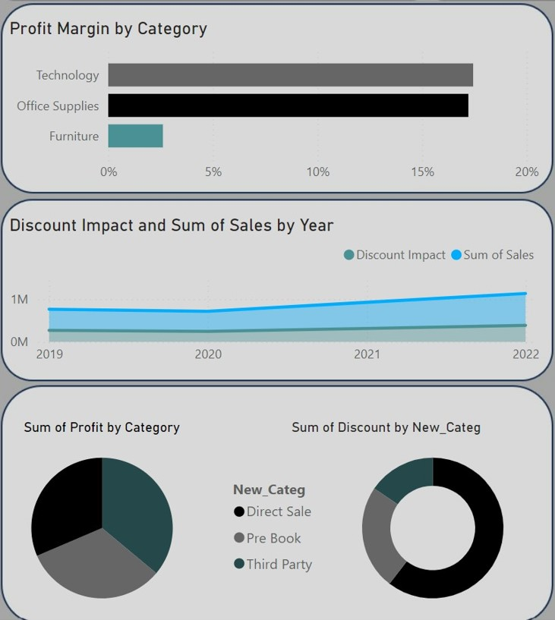


The bar chart compares profit margins for three categories: Technology, Office Supplies, and Furniture. Office Supplies has the highest profit margin, followed by Technology, while Furniture has the lowest margin.
Discount Impact and Sum of Sales by Year (Line Chart):
line chart illustrates the impact of discounts and total sales from 2019 to 2022. The light blue line indicates the discount impact, while the darker blue line represents total sales. Both lines show a gradual increase over the years.
Sum of Profit by Category (Pie Chart): This pie chart displays profit distribution among categories, highlighting contributions to overall profit.
Sum of Discount by New_Categ (Donut Chart): This donut chart shows total discounts by category, with segment size representing each category's share.

Slide 9
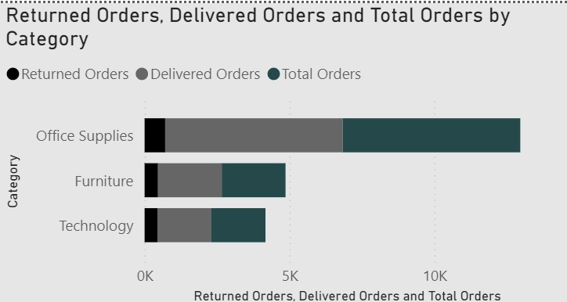
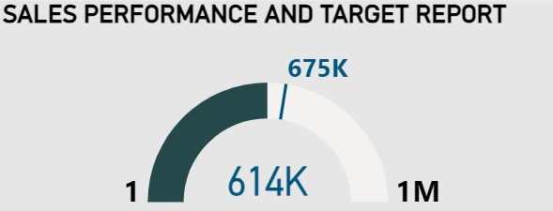
Sales Performance and Target Report (Gauge Chart):
This gauge chart tracks the current sales performance against a target of 1 million units or dollars (indicated as "1M").
The value displayed in blue text ("614K") represents the actual sales achieved so far, while "675K" is likely the goal at this stage of the period.
The needle shows how close the current sales are to the goal, giving a visual representation of progress.
Returned, Delivered, and Total Orders by Category (Stacked Bar Chart):
This stacked bar chart compares returned orders, delivered orders, and total orders for Office Supplies, Furniture, and Technology.
Office Supplies shows the highest number of total orders, with a smaller proportion of returned orders. Furniture and Technology have fewer total orders but relatively higher proportions of returns.

Slide 10
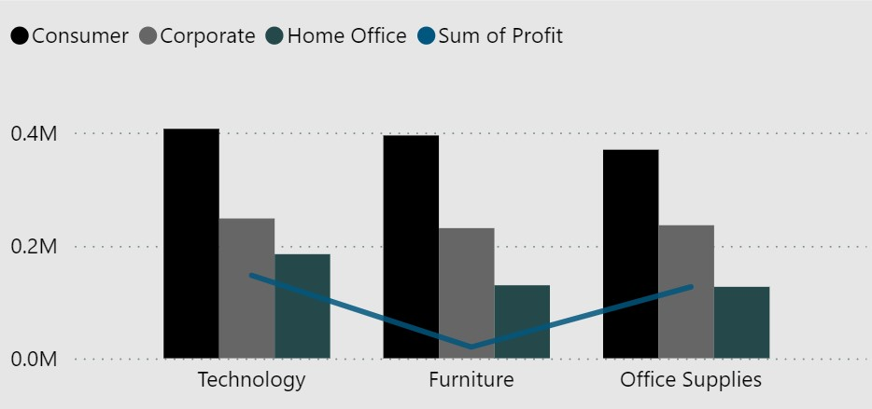
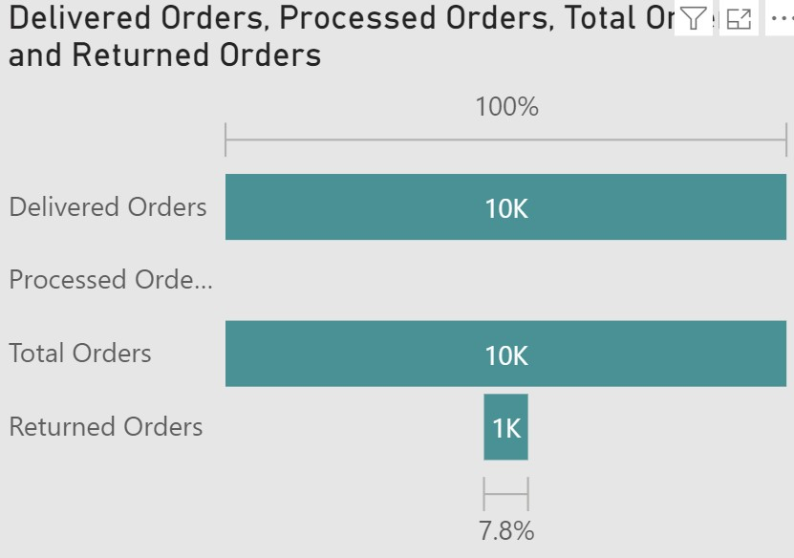
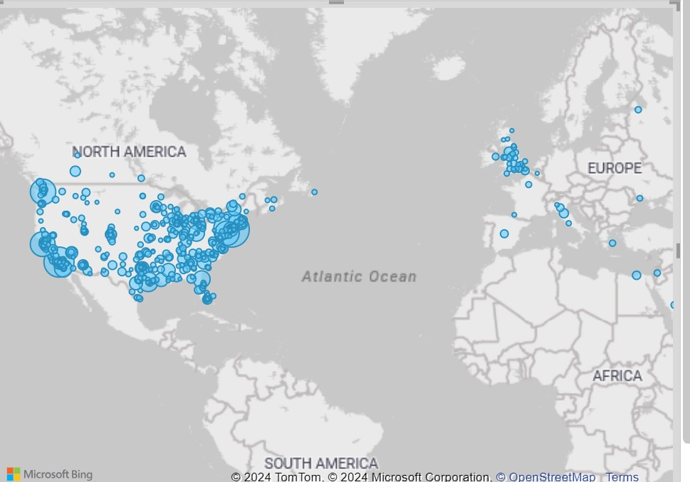
Profit by Segment and Category:
Displays sales from Consumer, Corporate, and Home Office segments for Technology, Furniture, and Office Supplies.
Technology leads in profit, with Consumer sales being the highest for Technology and Furniture.
Delivered, Processed, and Returned Orders:
10K orders were delivered and processed, with 1K returned, resulting in a 7.8% return rate.
Order Density Map:
This map shows the sum of sales across different cities
The size of the blue bubbles represents the total sales, with larger bubbles indicating higher sales volumes in specific cities.

Slide 11
UNLOCKING SALES INSIGHTS :
TRENDS AND RETURNS

Slide 12
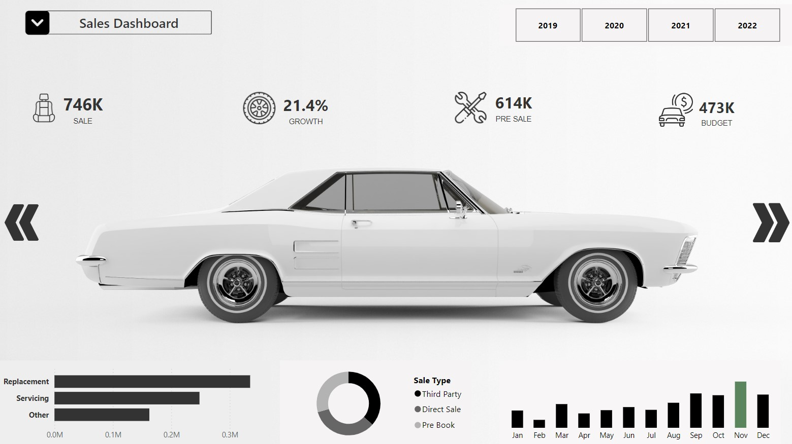


Slide 13
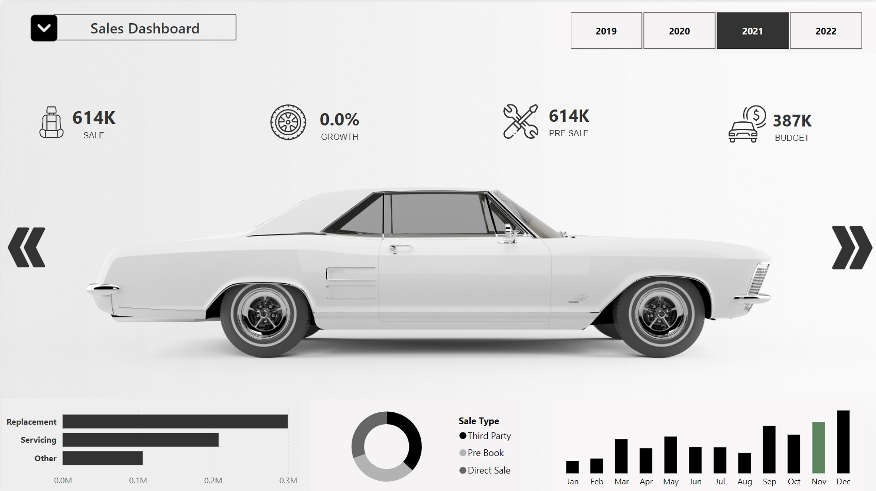

Slide 14
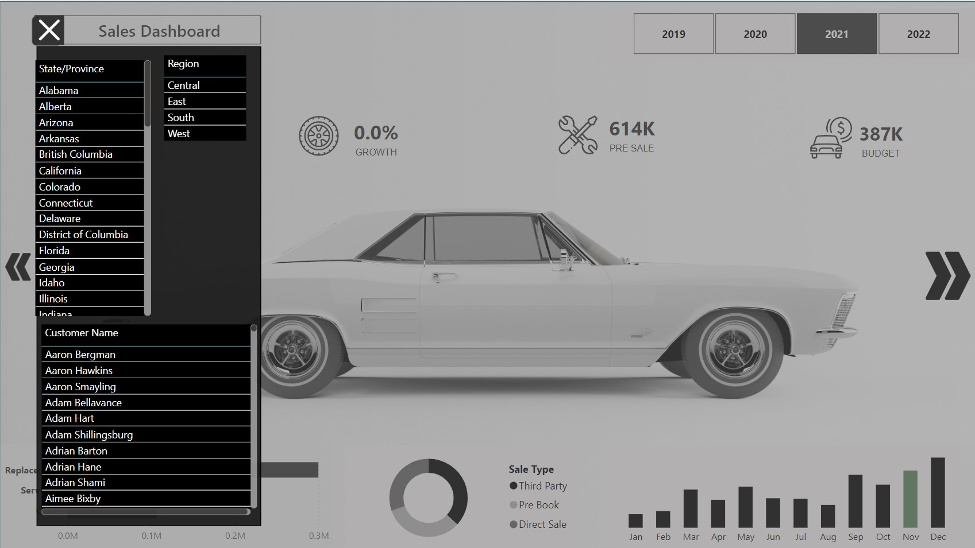


Slide 16
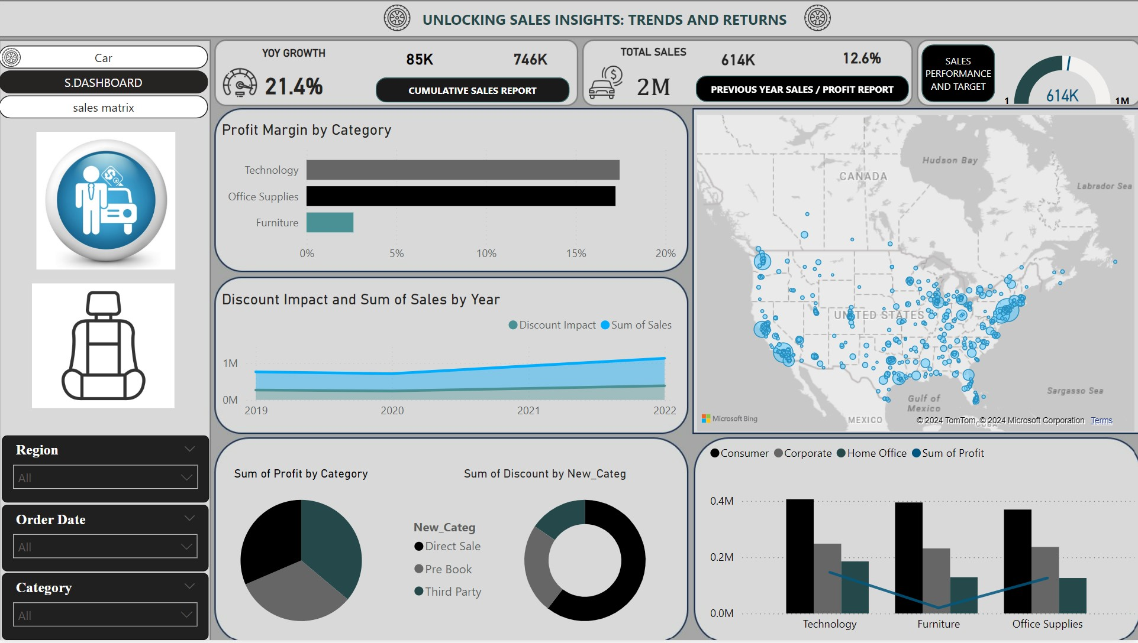

Slide 17
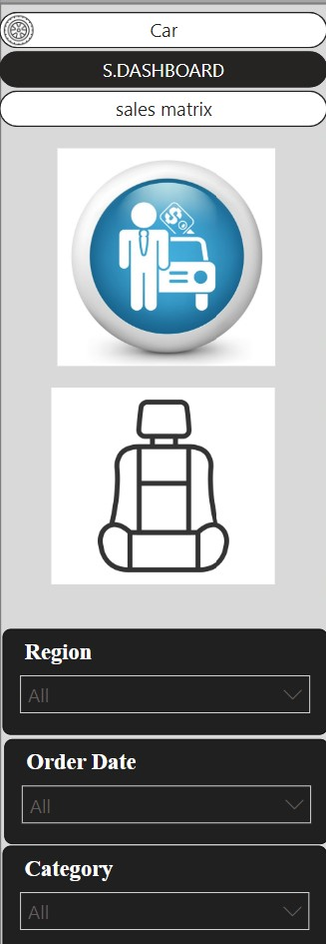
These three panels serve as navigation buttons, directing users to other pages that display additional visualizations.
SCLICER PANNEL
Adjusting any slicer will drastically change the visualizations, altering the displayed data and insights.

Slide 18
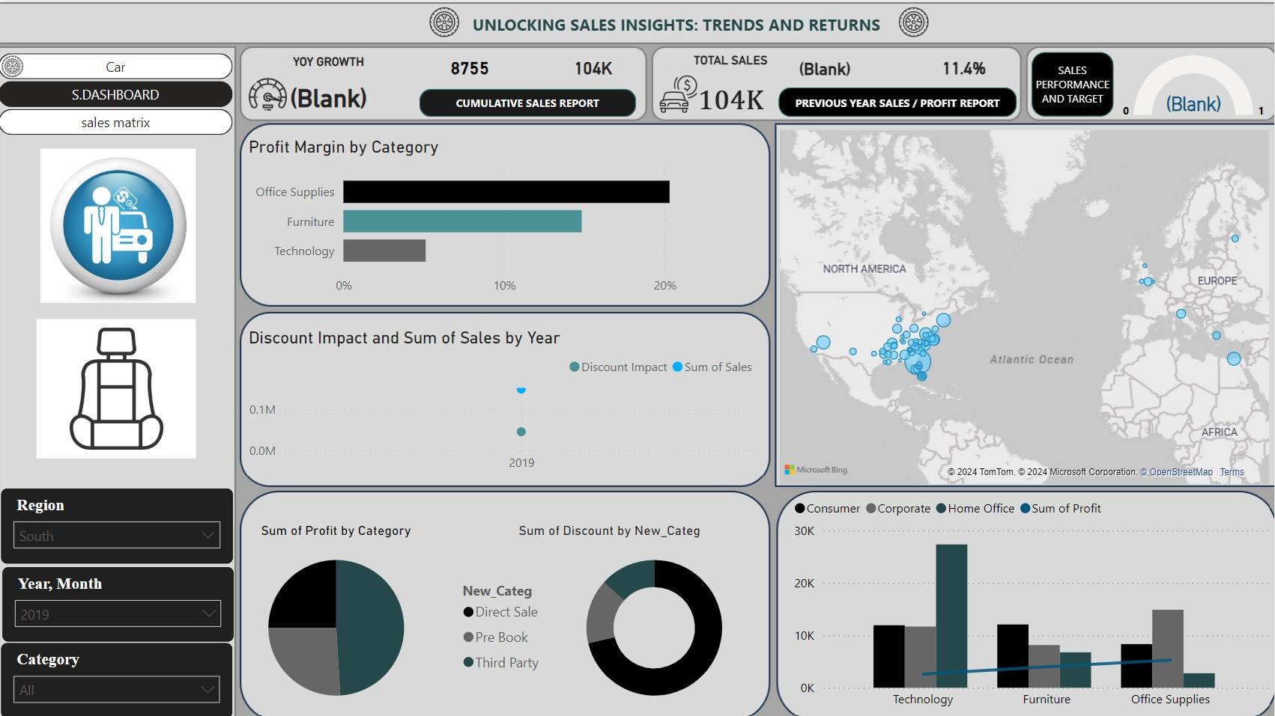

Slide 19
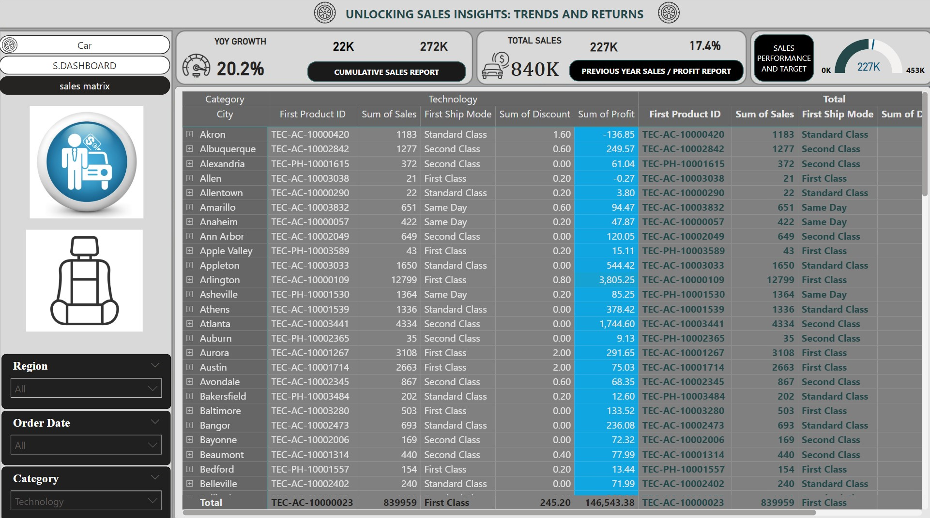

Slide 20
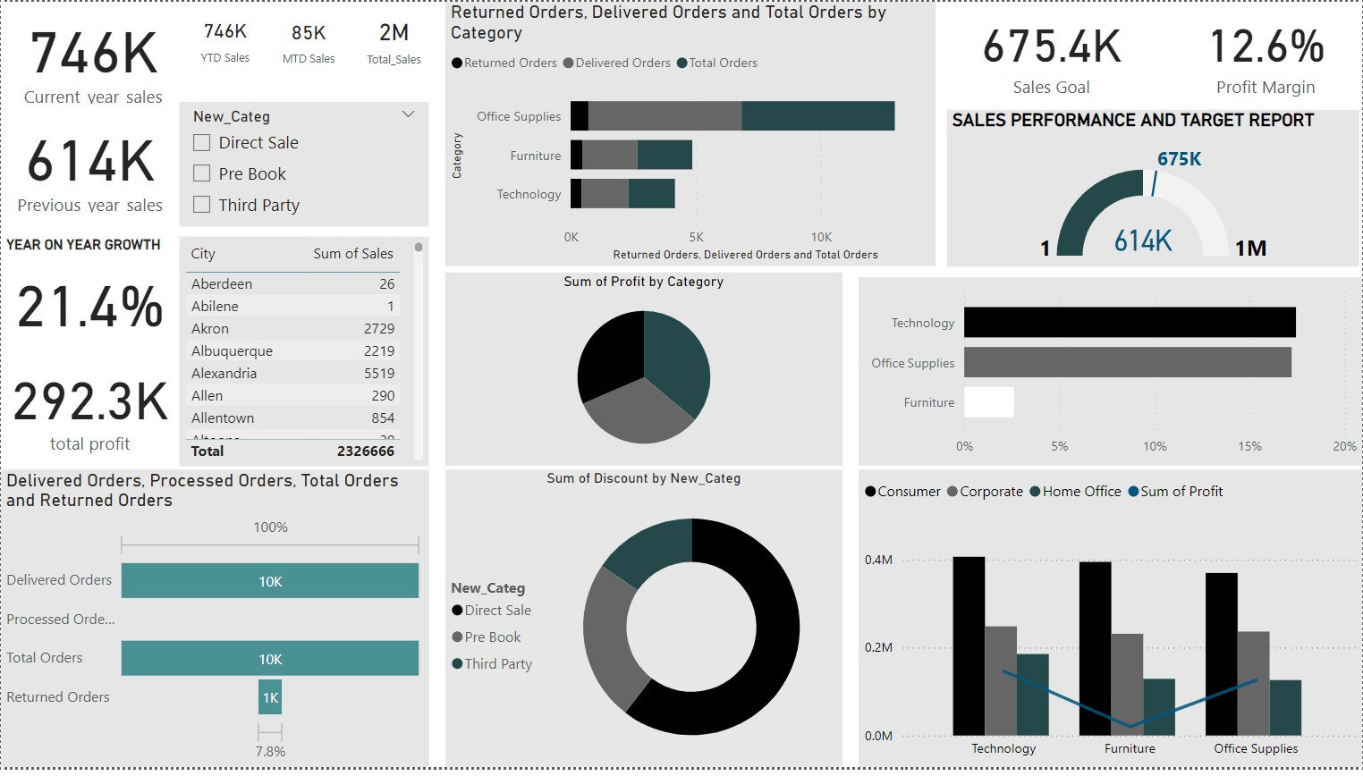

Slide 21

This Power BI dashboard offers a dynamic, interactive, and insightful view of sales performance, customer behavior, and return metrics across multiple regions and categories. By leveraging a well-structured dataset and new custom measures, the dashboard empowers decision-makers to:
Track Sales Trends: Monitor key metrics such as sales, profit, and growth across various regions, product categories, and customer segments.
Analyze Returns: Quickly identify patterns in returns and take actionable steps to reduce them.
Optimize Performance: Utilize visual tools like gauge charts and funnel charts to measure progress against sales goals and understand conversion metrics.
Data-Driven Insights: Gain valuable insights from detailed, up-to-date information through easily understandable visualizations, enabling informed decision-making.
With the ability to drill down into the data, filter by various dimensions, and track performance over time, this dashboard serves as an invaluable tool for driving business strategies, improving sales efficiency, and optimizing overall operations.
CONCLUSION

Slide 22

THANK YOU

